Slide 1
Car prediction
Machine learning
Present :Abdulrhman hulail
Mohammed alsheddi

Slide 2
Domain background
Use it in Car market
Help to design pricing for car

Slide 3
Problem statement Solution statement
It difficult to pricing a new car for company want sell his new car
May the value of car price not correct
Because may it depend on wrongs predict
learning a model to predict car pricingHow?
With dataset and features for cars we can design model to predict car price
We will use linear regression

Slide 4
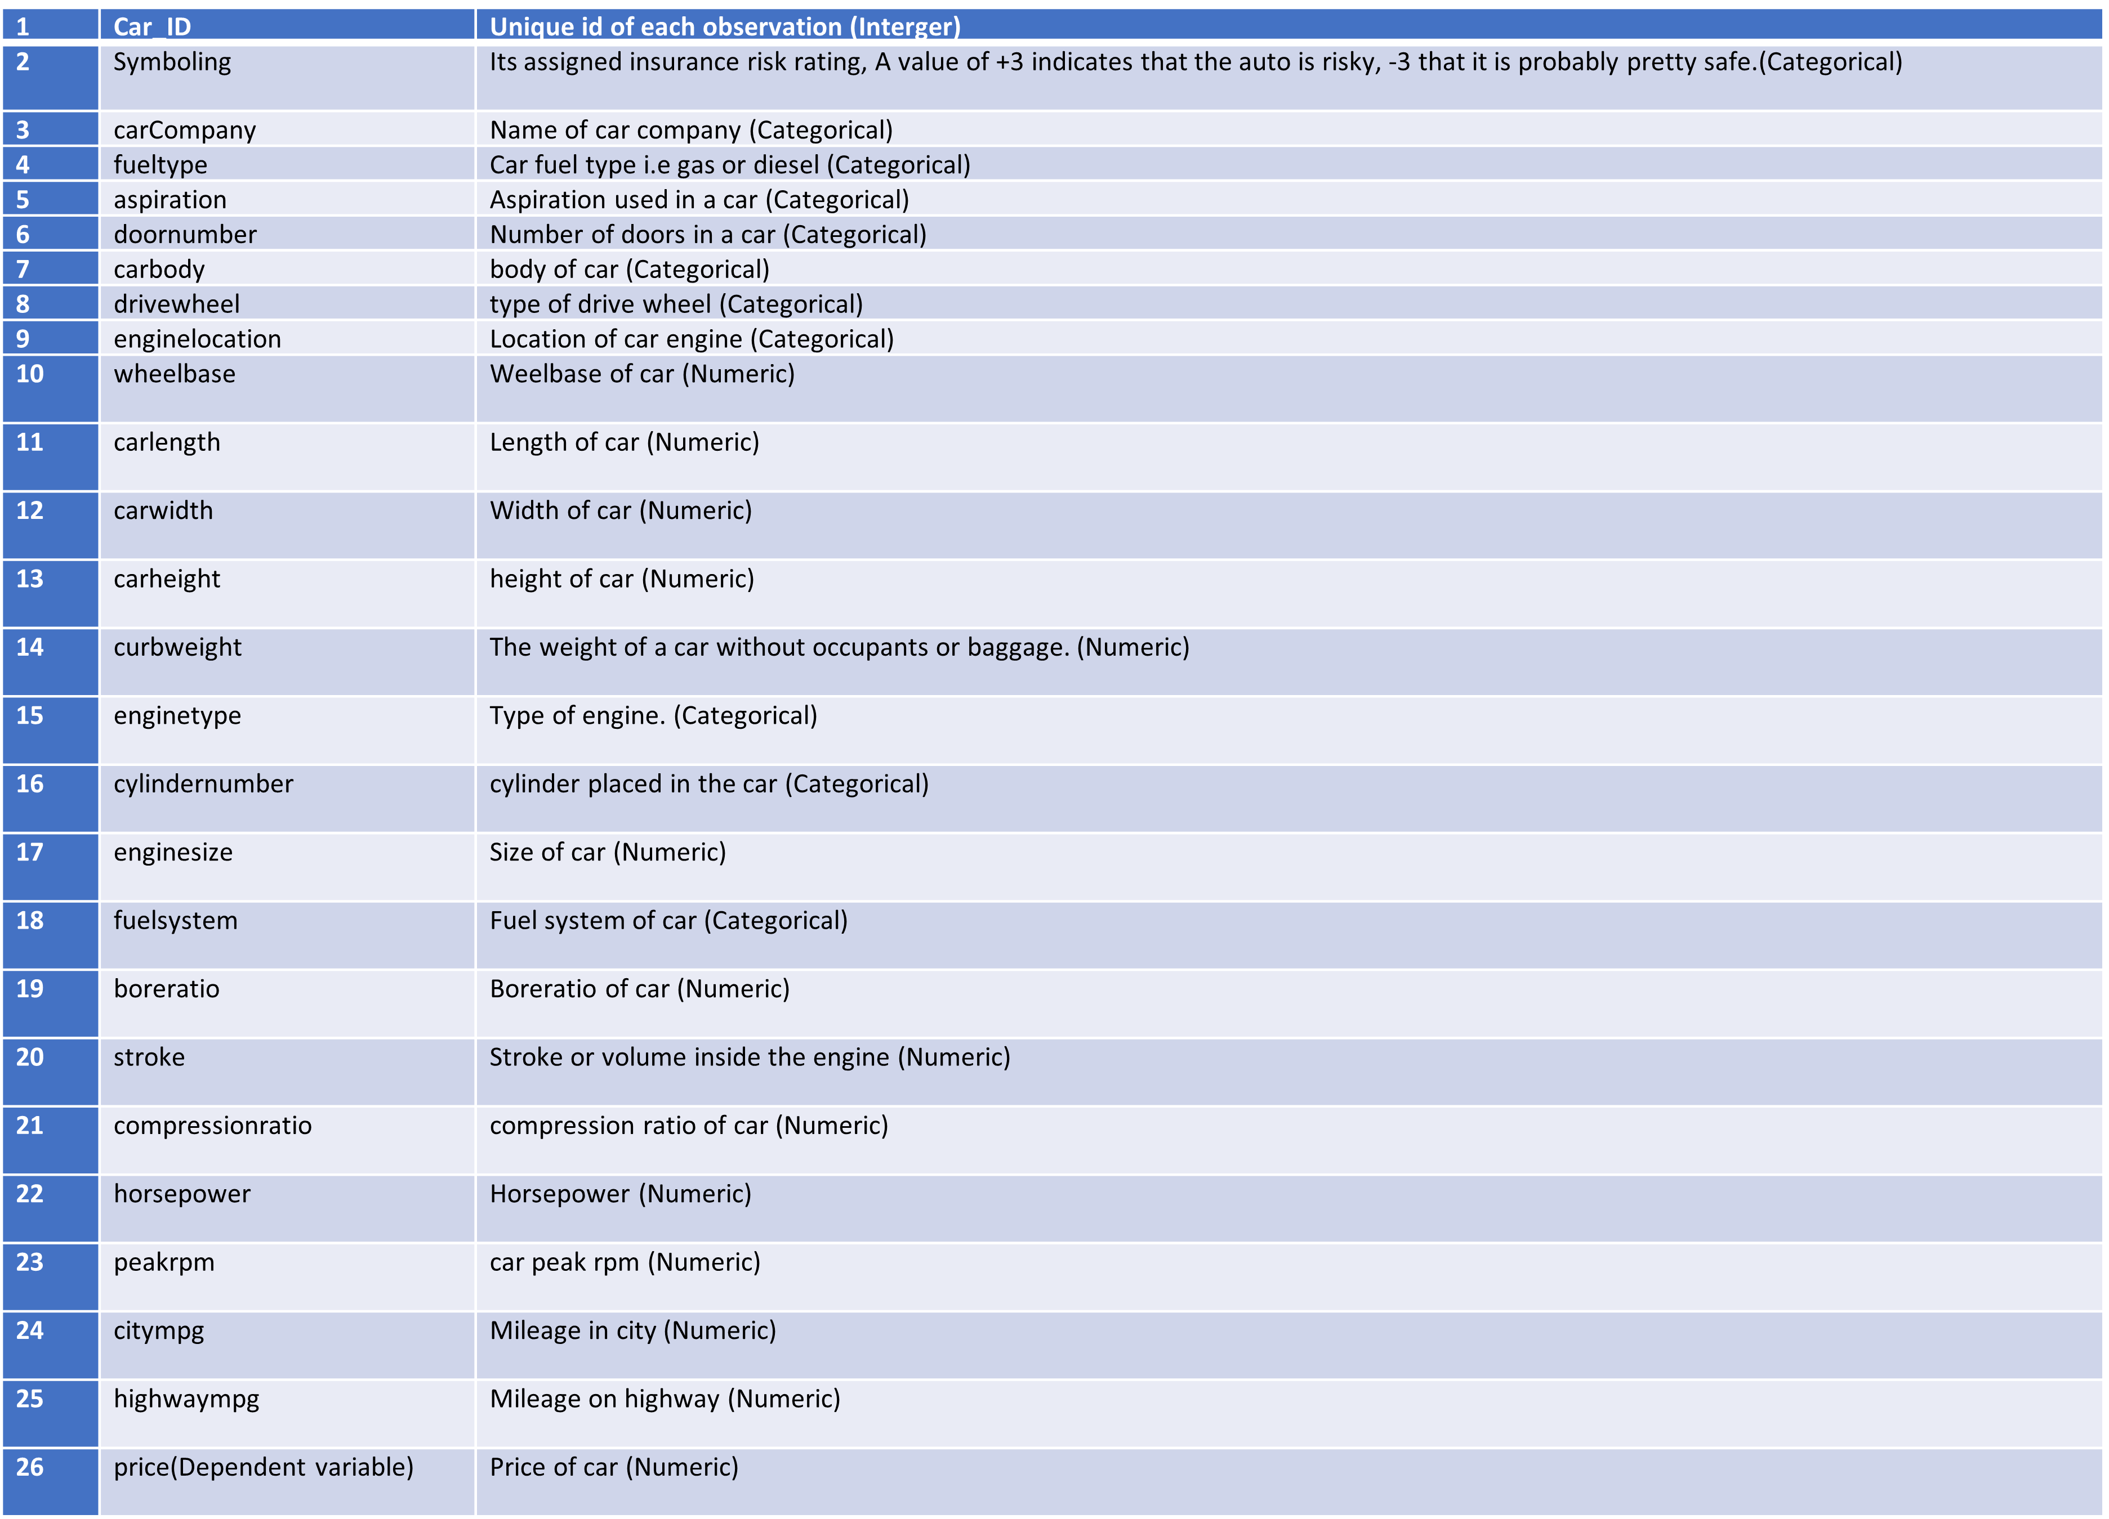
Dataset and there input

Slide 5
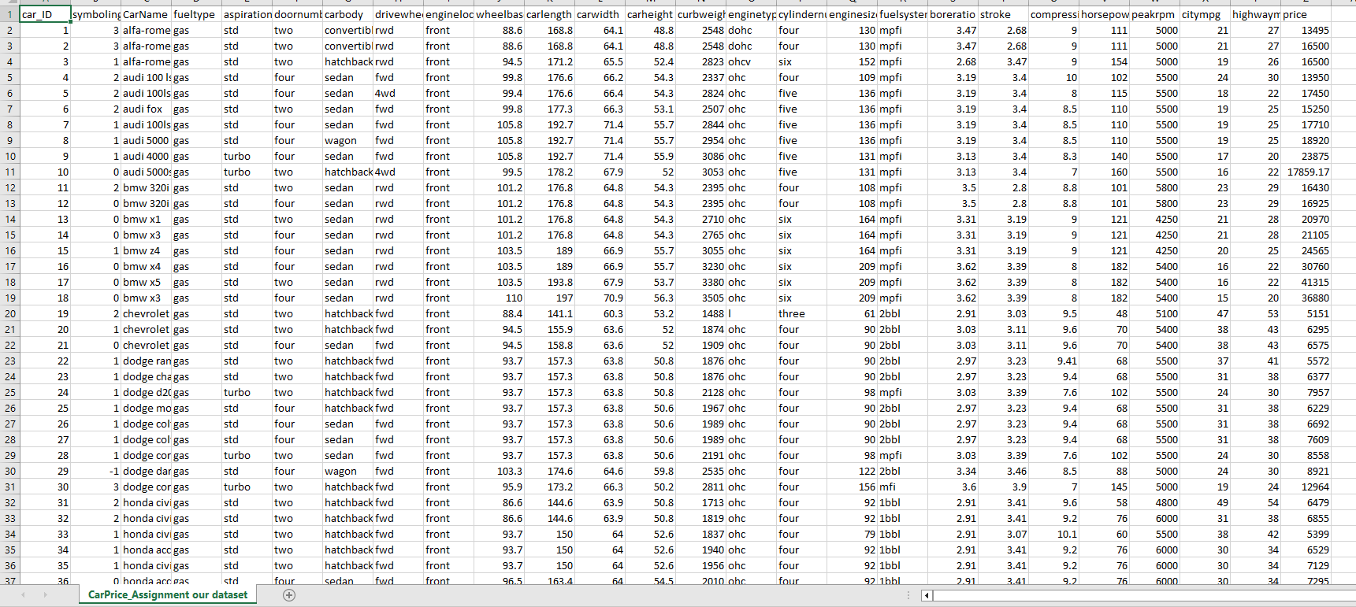
Dataset and there input

Slide 6
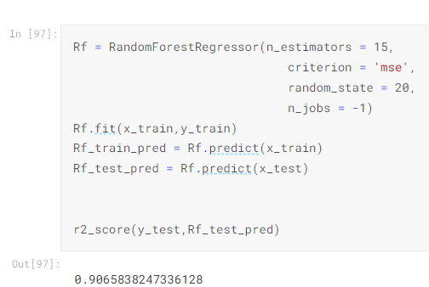
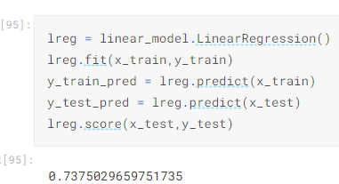
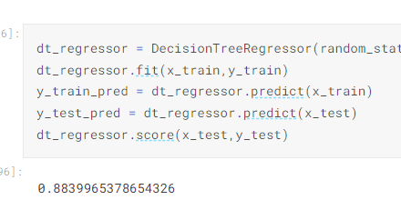
Benchmark models
Random forest Regression
Decision Tree Regression
Linear Regression

Slide 7
Evaluation metrics
Linear regression
R squared (R2)
Mean absolute error (MAE)
Mean squared error(MSE)

Slide 8
How we design it?
Clean data
Visualizing the features
Convert to integer
Feature scaling
Split data set
Fitting
Evaluate result of features from test data
Compare predicted label with test label

